Slide 1
Time Series Analysis Using Stata
Li Tang
ltang@imf.org
Econometric Modeling and Support Team
econometricsupport@imf.org

Slide 2
Summary: work with date variables
If the original date variable is string (i.e. color red):
gen week= weekly(stringvar,"wy")
gen month= monthly(stringvar,"my")
gen quarter= quarterly(stringvar,"qy")
gen half = halfyearly(stringvar,"hy")
gen year= yearly(stringvar,"y")
If the components of the original date are in different numeric variables (i.e. color black):
gen daily = mdy(month,day,year)
gen week = yw(year, week)
gen month = ym(year,month)
gen quarter = yq(year,quarter)
gen half = yh(year,half-year)
To extract days of the week (Monday, Tuesday, etc.) use the function dow()
gen dayofweek= dow(date)

Slide 3
Time series operators
Declare time series data and variables
tsset
Time series operators(L.; F.; D.)
Lagged variables: L1.dgdp L2. dgdp
Lead variables: F1.dgdp, F2.dgdp
Differenced variables: D1.dgdp, D2.dgdp
The operators may also be used in a regression
Example:
gen dgdpL1=L1.dgdp
gen dgdpL2=L2.dgdp
list ndate dgdp dgdpL1 dgdpL2 in 1/5
reg dgdp L(1/4).dgdp
reg dgdp L(1/4).(dgdp unemployment)

Slide 4
Summary of operators
Operator | Example | Meaning
L. | L.y | Lag: y(t‐1)
L2. | L2.y | 2‐period lag: y(t‐2)
F. | F.y | Lead: y(t+1)
F2. | F2.y | 2‐period lead: y(t+2)
D. | D.y | Difference: y(t)‐y(t‐1)
D2. | D2.y | Double difference: (y(t)‐y(t‐1))‐(y(t‐1)‐y(t‐2))

Slide 5
A useful function: tin()
This function can be used to restrict the estimation sample. Note: You must have previously tsset the data to use tin().
if tin(1948Q1, 1968Q1)
It is equivalent to
if quarter>=tq(1948Q1) & quarter<=tq(1968Q1)
tin() can be used to produce out of sample forecast
predict sp500hat if tin(1968Q2,1987Q4)
tsline sp500hat if tin(1968Q2,1987Q4)

Slide 6
Filtering time series
tsfilter command separates a time series into trend and cyclical components: the Baxter-King, Butterworth, Chistiano-Fitzgerald, and Hodrick-Prescott filters.
tsfilter hp command may be applied to a single variable or to a list of multiple variables.
Example
Use the Baxter-King filter to estimate the cyclical component of the log of quarterly U.S. GDP
webuse gdp2
tsfilter bk gdp_bk = gdp_ln

Slide 7
Autocorrelation
Autocorrelation: correlation between a variable and its previous value.
For example, autoregression model of order p.
AR(p):
Example
webuse gdp2
tsset
corrgram gdp, lags(12)

Slide 8
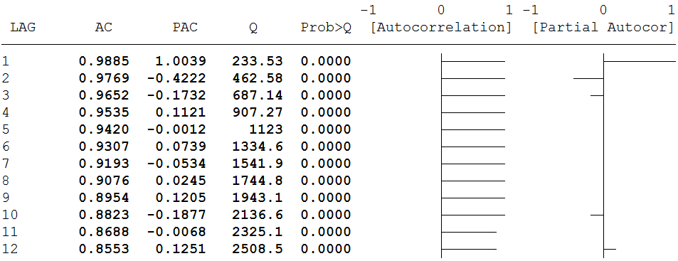
AC: 0.9535 – correlation between the current value of gdp and its value four quarters ago. AC can be used to defined the q in MA(q) only in stationary series. | PAC 0.1121 – correlation between the current value of gdp and its value four quarters ago without the effect of the three previous lags. I.e., ϕ4 PAC can be used to define the p in AR(p) only in stationary series | Box-Pierce’ Q statistic tests the null hypothesis that all correlation up to lag k are equal to 0. This series show significant autocorrelation as shown in the Prob>Q value which at any k are less than 0.05, therefore rejecting the null that all lags are not autocorrelated. | Graphic view of AC which shows a slow decay in the trend, suggesting nonstationarity. | Graphic view of PAC which does not show spikes after the third lag which suggests that all other lags are mirrors of the third lag.

Slide 9
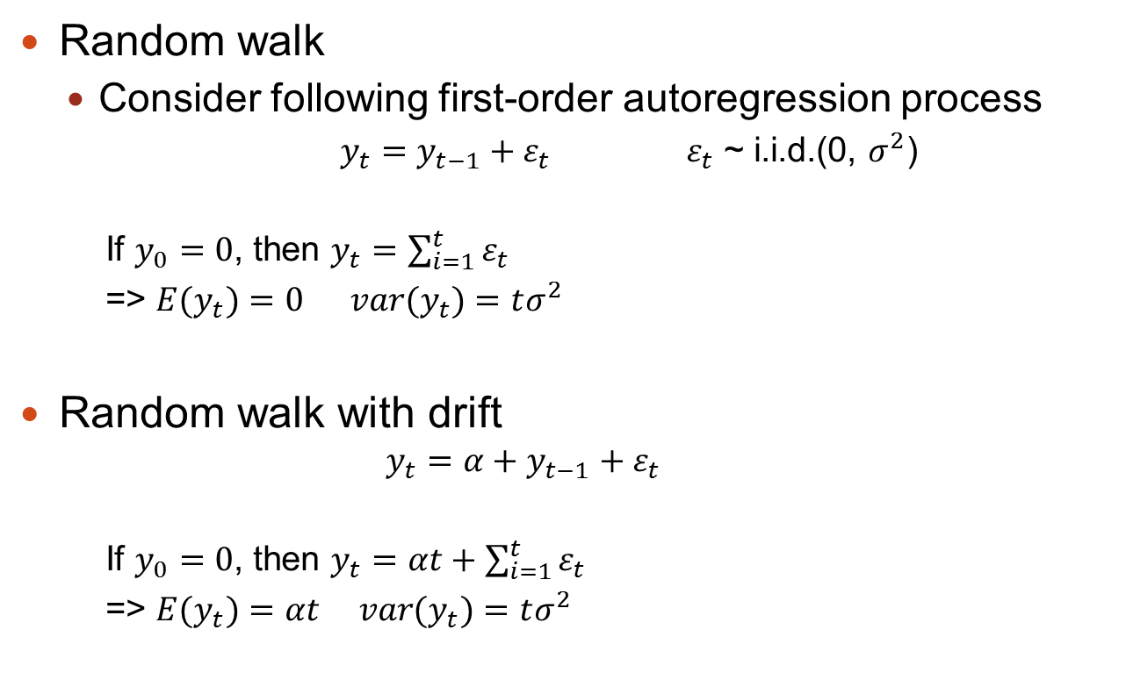
Stochastic Trend
Random walk
Consider following first-order autoregression process
$y_{t}=y_{t−1}+ε_{t}$ $ε_{t}$ ~ i.i.d.(0, $σ^{2}$)
If $y_{0}=0$, then $y_{t}=\sum_{i=1}^{t}{ε_{t}}$
=> ${E(y}_{t})=0 var(y_{t})=tσ^{2}$
Random walk with drift
$$y_{t}={α+y}_{t−1}+ε_{t}$$
If $y_{0}=0$, then $y_{t}=αt+\sum_{i=1}^{t}{ε_{t}}$
=> ${E(y}_{t})=αt var(y_{t})=tσ^{2}$

Slide 10
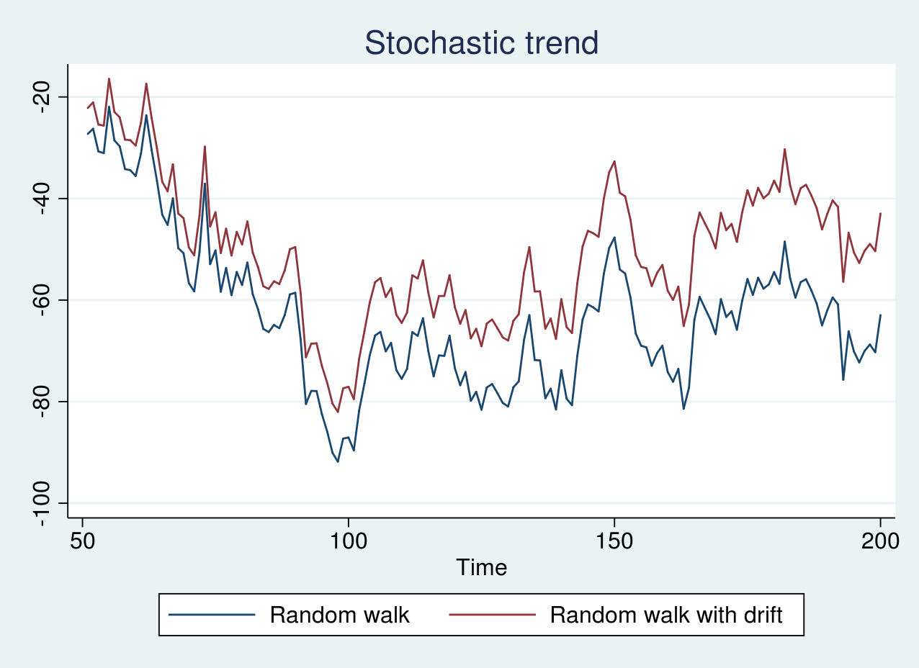

Slide 11
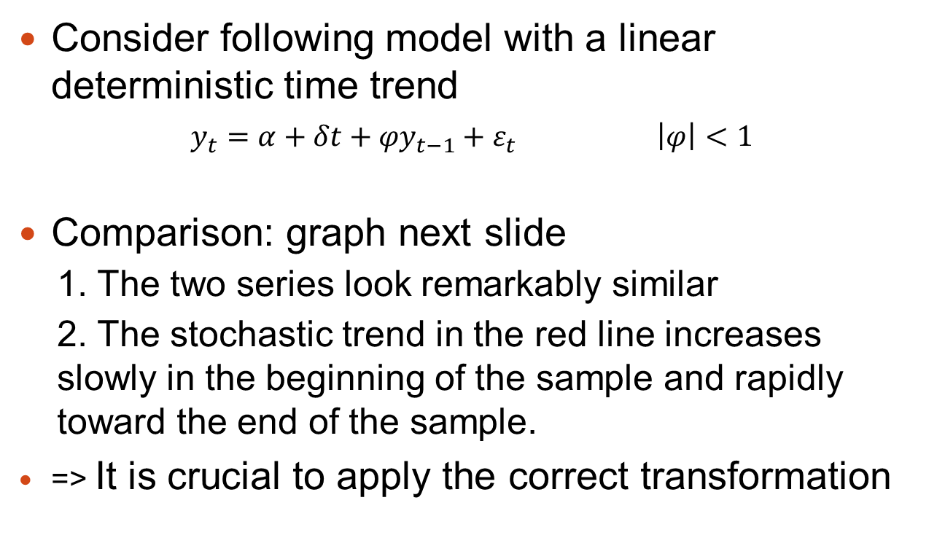
Deterministic trend
Consider following model with a linear deterministic time trend
$y_{t}={α+δt+φy}_{t−1}+ε_{t} \left|φ\right|<1$
Comparison: graph next slide
1. The two series look remarkably similar
2. The stochastic trend in the red line increases slowly in the beginning of the sample and rapidly toward the end of the sample.
=> It is crucial to apply the correct transformation

Slide 12
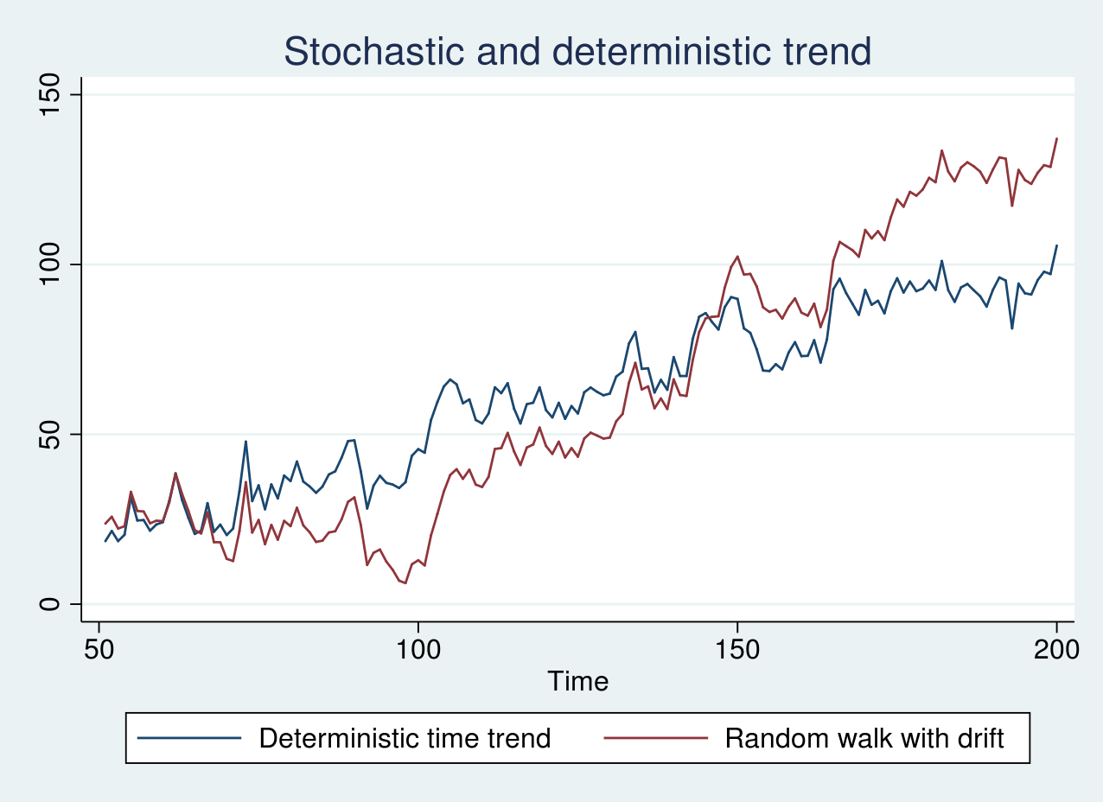

Slide 13
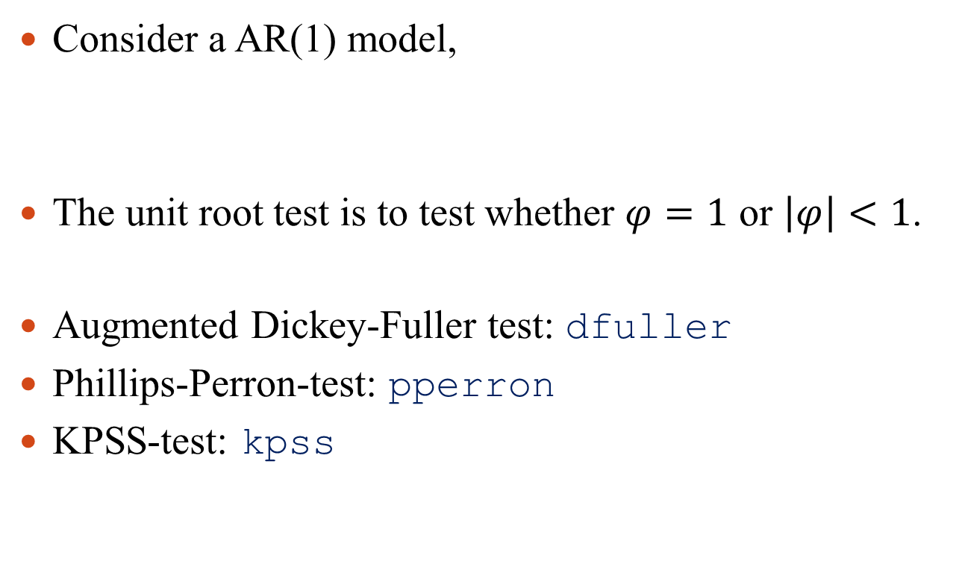
Unit root test
Consider a AR(1) model,
The unit root test is to test whether $φ=1$ or $\left|φ\right|<1$.
Augmented Dickey-Fuller test: dfuller
Phillips-Perron-test: pperron
KPSS-test: kpss
$y_{t}={φy}_{t−1}+ε_{t} \left|φ\right|<1$

Slide 14
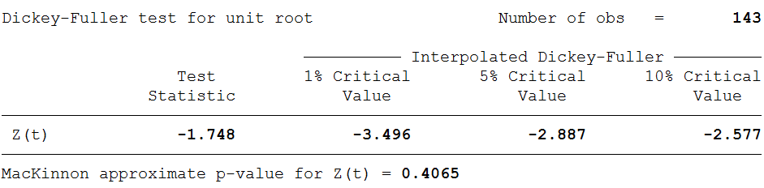

Augmented Dickey-Fuller test
H0: $φ=1$
webuse air2
line air t
* H0: random walk
* H1: stationary
dfuller air
fail to reject

Slide 15
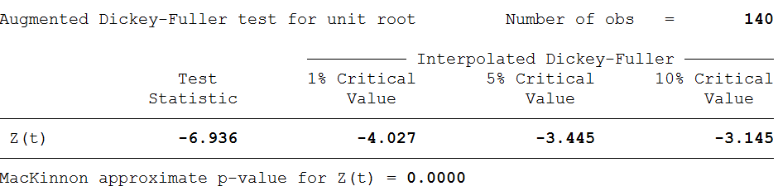
Augmented Dickey-Fuller test
* H0: random walk with a possible drift
* H1: stationary around a linear time trend
dfuller air, lags(3) trend regress
reject

Slide 16
Phillips–Perron test
Accounts for the potential serial correlation and heteroskedasticity in the residuals.
H0: a random walk with a possible drift
H1: the series is stationary around a linear time trend, or the series is stationary around a possible nonzero mean with no time trend
H0: stationary around a deterministic trend
H1: random walk
Kwiatkowski-Phillips-Schmidt-Shin test

Slide 17
Vector autoregressive (VAR) models
A vector-autoregressive (VAR) model is a multivariate way of modeling time series.
Let a simple bivariate VAR(2)-process be the following
In the above example, we have two series GDP_{t} and M_{t} , we want to explain these two with own past realizations and past realizations of the other series.

Slide 18
Vector autoregressive (VAR) models
In general a VAR(p)-process would be:
To estimate a VAR model, use the command var:
webuse lutkepohl2
tsset
var dln_inv dln_inc dln_consump
Symbols | Meaning
y_{t} | Vector containing the different time series.
c | Vector of constants
ε_{t} | Error term, ε_{t}~N(0, Σ)
Σ | Variance-covariance matrix of the error term

Slide 19
VAR diagnosis
We want to correctly specify our VAR model, and correctly interpret the results. Performing VAR diagnosis is usually necessary.
Summary of VAR diagnosis commands
Command | Usage
varsoc | Choosing the optimal number of lags
varstable | Testing for VAR stability
vargranger | Testing for Granger causality
varlmar | Testing for autocorrelation

Slide 20
VAR diagnosis: lag selection
Too many lags could increase the error in the forecasts, too few could leave out relevant information. Experience, knowledge and theory are usually the best way to determine the number of lags needed.
varsoc
A sequence of likelihood-ratio test statistics for all the full VARs of order less than or equal to the highest lag order is also reported.
We select the lag length corresponding to the lowest value. An ‘*’ indicates the optimal lag.

Slide 21
VAR diagnosis: lag selection
Example
webuse lutkepohl2
varsoc dln_inv dln_inc dln_consump
Summary
Symbols | Meaning | Usage
AIC | Akaike’s information criterion | monthly data
SBIC | Schwarz’s Bayesian information criterion | any sample size for quarterly data
HQIC | Hannan and Quinn information criterion | quarterly data on samples over 120
FPE | final prediction error

Slide 22
VAR diagnosis: VAR stability
The stability of a VAR can be examined by calculating the roots of:
The characteristic polynomial is defined as:
The necessary and sufficient condition for stability is that all characteristic roots that solves lie inside the unit circle.
Testing for VAR stability: varstable.

Slide 23
VAR diagnosis: VAR stability
Example
webuse lutkepohl2
var dln_inv dln_inc dln_consump
varstable, graph

Slide 24
VAR diagnosis: autocorrelation
We want to test whether there is autocorrelation in the residuals. If the null hypothesis (there is no autocorrelation) is rejected, we need to consider increasing lag length in the VAR model. If the null hypothesis is accepted, then this test gives no hint of model misspecification.
Example
webuse lutkepohl2
var dln_inv dln_inc dln_consump
varlmar, mlag(5)

Slide 25
VAR diagnosis: Granger causality
The Granger causality test is a statistical hypothesis test for determining whether one time series is useful in forecasting another.
Consider our example with two variables: and
To test whether is useful in forecasting , we need to test:
Testing for Granger causality: vargranger.

Slide 26
VAR diagnosis: Granger causality
Example
webuse lutkepohl2
var dln_inv dln_inc
vargranger
Note: the null hypothesis is that the coefficients are 0.
Granger causality test may help to establish a sensible casual ordering. (see SVAR)

Slide 27
Estimation of SVAR
A structural vector-autoregressive (SVAR) model imposes restrictions on the response of variables on each other based on the underlying VAR model.
We want to know what is the effect of an unit shock of one variable on another variable, while imposing restrictions. For example, current M2 has no effect on current GDP but GDP has an effect on current M2.

Slide 28
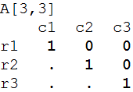
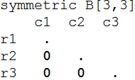
Estimation of SVAR
A short run SVAR without exogenous variables can be written as:
where ε_{t} is a K×1 vector of innovations with ε _{t} ~N(0, Σ), which represents the original shocks, and e_{t} are a set of orthogonalized disturbances with e _{t} ~N(0, I).
For example, A and B matrices.

Slide 29
Estimation of SVAR
A and B matrices:
Missing values in those matrices indicate entries to be estimated; entries with given values are assumed to be fixed.
A is lower triangular. The diagonals of the A matrix is restricted to unity, elements above the main diagonal are set to zero, and the elements below the main diagonal are to be estimated.
B = I. The diagonal of the B matrix is to be estimated and the remaining entries are zero.

Slide 30
Estimation of SVAR
Causal ordering on the variables in the VAR given lower triangular A and diagonal B:
Shocks to one equation contemporaneously affect variables below that equation but only affect variables above that equation with a lag.
Example:
webuse lutkepohl2
matrix A = (1,0,0\.,1,0\.,.,1)
matrix B = (.,0,0\0,.,0\0,0,.)
matrix list A
matrix list B
svar dln_inv dln_inc dln_consump if qtr<=tq(1978q4), aeq(A) beq(B)

Slide 31
Impulse response function
Let Y_{t} be a k-dimensional vector series generated by
where is the MA coefficients measuring the impulse response. More specially, represents the response of variable j to an unit impulse in variable k occurring i-th period ago.

Slide 32
Impulse response function
Example
webuse lutkepohl2
var dln_inv dln_inc dln_consump if qtr<=tq(1978q4), lags(1/2) dfk
irf create order1, step(10) set(myirf1)
irf graph oirf, impulse(dln_inc) response(dln_consump)

Slide 33
Cointegration
Consider two time series x_{t} and y_{t} , that are both unit root processes. x_{t} and y_{t} are said to be cointegrated if there exists a parameter α such that u_{t} = y_{t} - α x_{t} is a stationary process.
Example
ssc install johans
use http://fmwww.bc.edu/ec-p/data/macro/wgmacro.dta, clear
johans investment income consumption, l(4) nonormal

Slide 34
Vector Error Correction Models
We define the error correction term as u_{t} = y_{t} - α x_{t}
Re-arrange the cointegration relation, we have
Example
webuse rdinc
vec ln_ne ln_se
-1

